Slide 1
Finite Automaton
Lecture 2
Rowaida AL-Amri

Slide 2
Syllabus

Slide 3
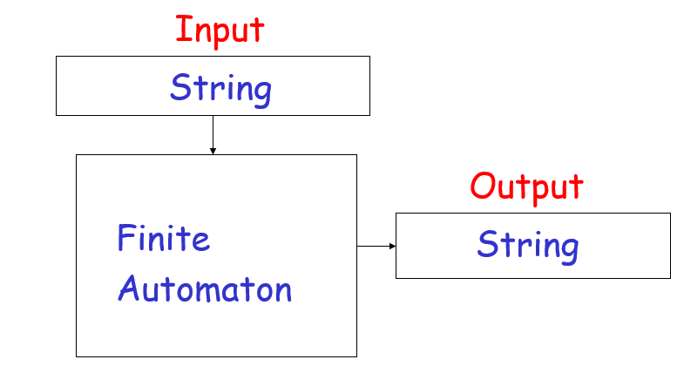
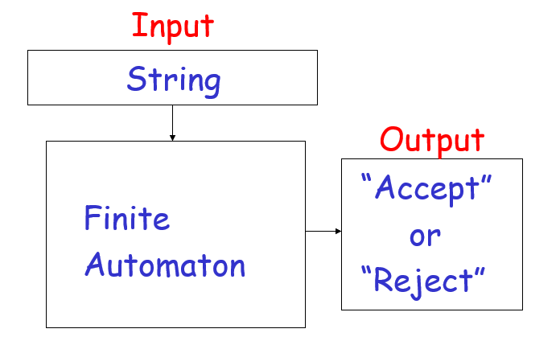
Finite Automata

Slide 4
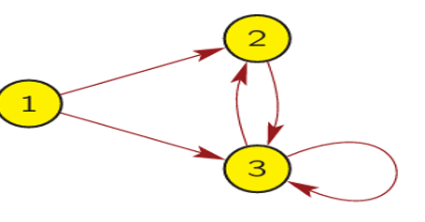
introduction
The Finite Automaton is a model that consists of a finite number of states, moves between them when reading input symbols, and is used to determine whether a given string belongs to a regular language or not. It is one of the most important fundamental concepts in the theory of computation and compiler design.
A finite automaton is a mathematical model used to simulate how a computer processes text or data step by step.

Slide 5
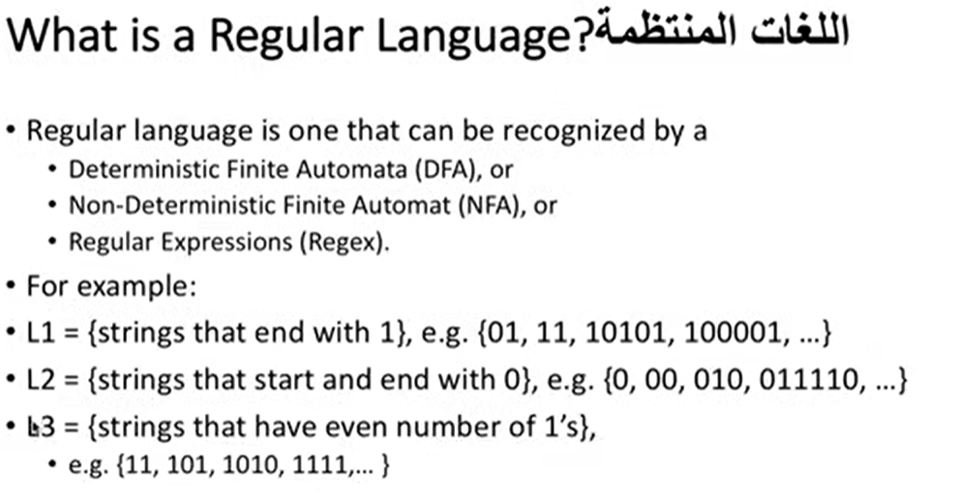

Slide 6
Finite Automata(definition)
Automation : Automation refers to the automatic execution of certain processes and the generation of results from those processes الاتمتة تدل على التنفيذ التلقائي لعمليات معينة وتوليد نتيجة لهذه العمليات
An Automation with a finite number of states is called a Finite Automata (FA) or Finite State Machines(FSM)
A Finite Automaton is a mathematical model used in computer science to describe systems that respond to a sequence of inputs according to specific rules.
Another definition
a Finite State Machine(FSM) is a mechanism used to recognise a particular pattern in a given input. FSM can be used to recognise keywords like ‘while’ and ‘for’ in a given C program.

Slide 7
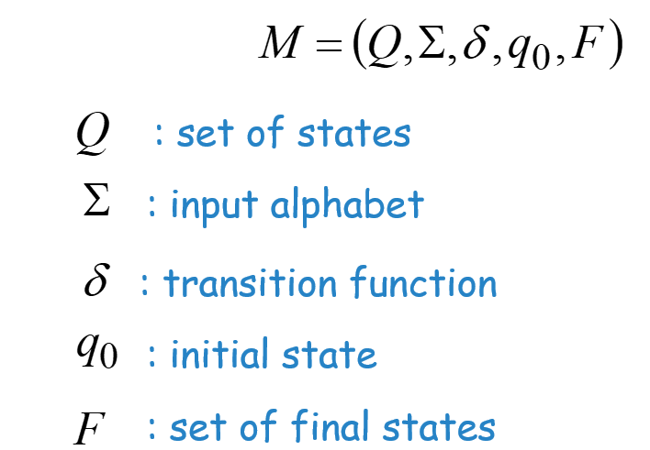
Finite Automata(elements)
It consists of five main elements:
1- Set of States: A set of states the machine can be in, such as: Q = {q0, q1, q2}
2- Alphabet: A set of symbols the machine accepts, such as:Σ = {0, 1}
3- Transition Function: Determines which state the machine transitions to when it reads a specific symbol.
4- Start State: The state from which the machine begins, often denoted by q0.
5- Accept/Final States: If the machine ends up in one of these states after reading the entire input,
the string is accepted.

Slide 8
Finite Automata(work)
How a finite automaton works?
The machine starts in an initial state, then reads the input symbols one by one. With each symbol, it transitions to a new state according to the transition function. After all symbols have been processed:
If it is in a final state → the string is accepted.
If it is not in a final state → the string is rejected.

Slide 9
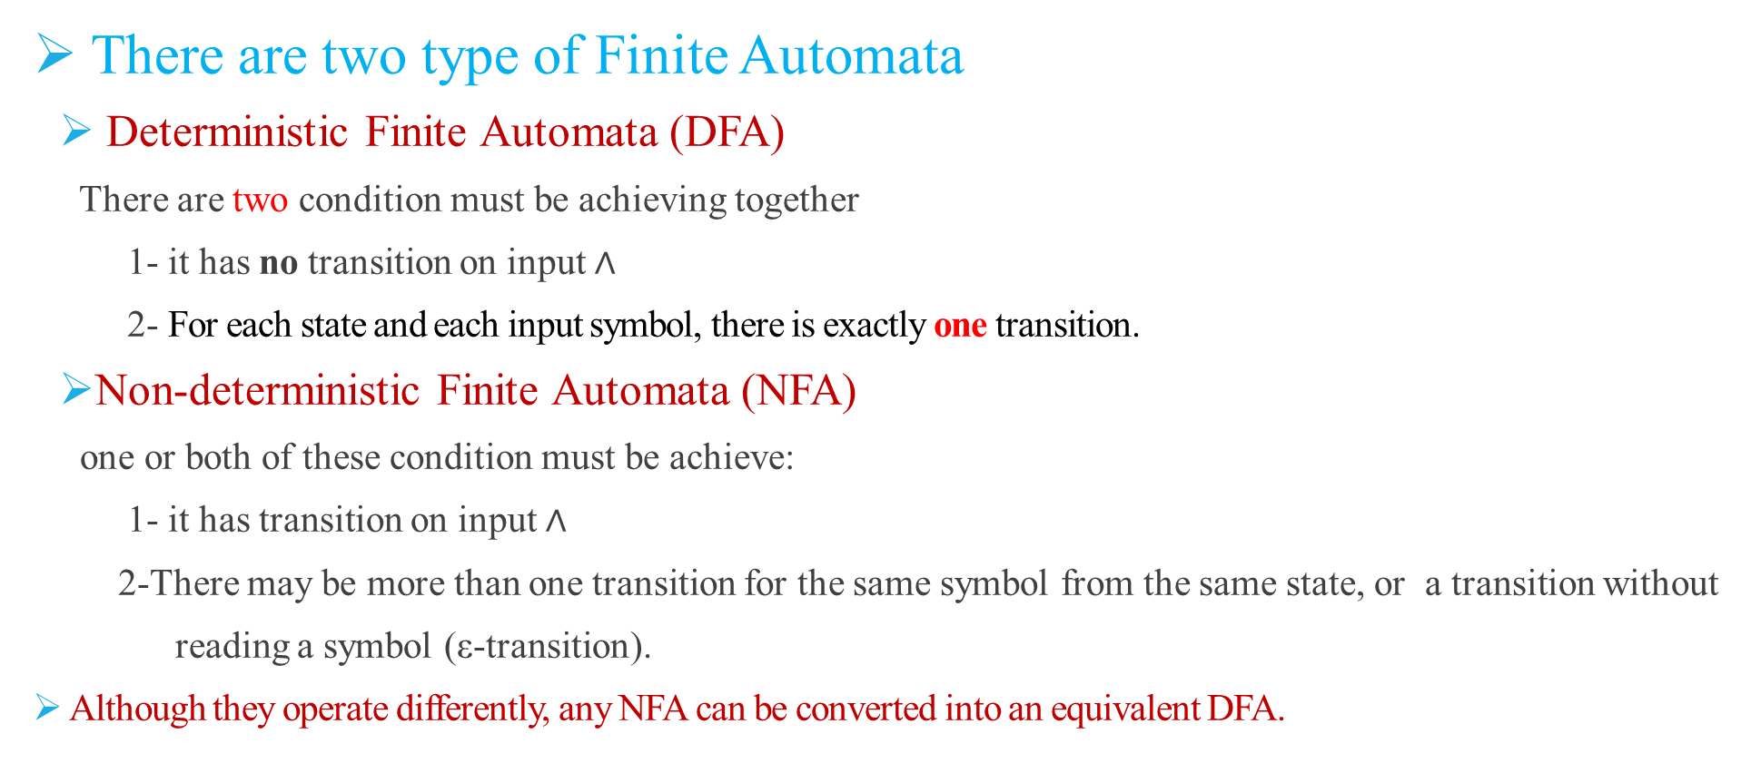
Finite Automata(types)
There are two type of Finite Automata
Deterministic Finite Automata (DFA)
There are two condition must be achieving together
1- it has no transition on input $∧$
2- For each state and each input symbol, there is exactly one transition.
Non-deterministic Finite Automata (NFA)
one or both of these condition must be achieve:
1- it has transition on input $∧$
2-There may be more than one transition for the same symbol from the same state, or a transition without
reading a symbol (ε-transition).
Although they operate differently, any NFA can be converted into an equivalent DFA.

Slide 10
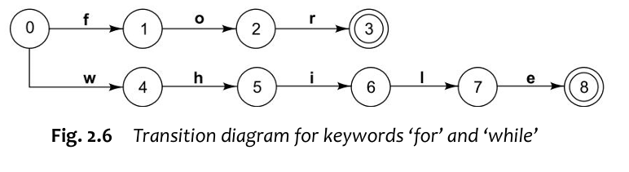
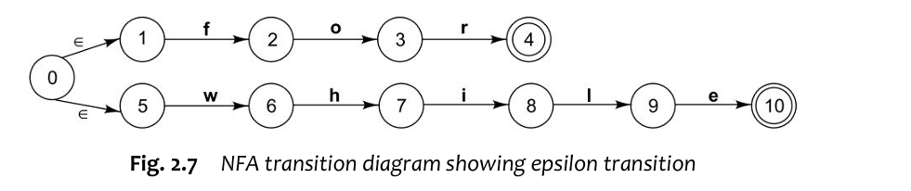
Finite Automata(types)
deterministic finite automaton ( DFA) : It is called deterministic because the next state can be determined by knowing the current state and the next input character.
non-deterministic finite state machine (NFA). An NFA differs from the DFA in the following aspects:
An empty transition denoted by special symbol Œ — epsilon is possible in NFA. This transition (also called as epsilon transition) can be made on empty string without advancing input

Slide 11
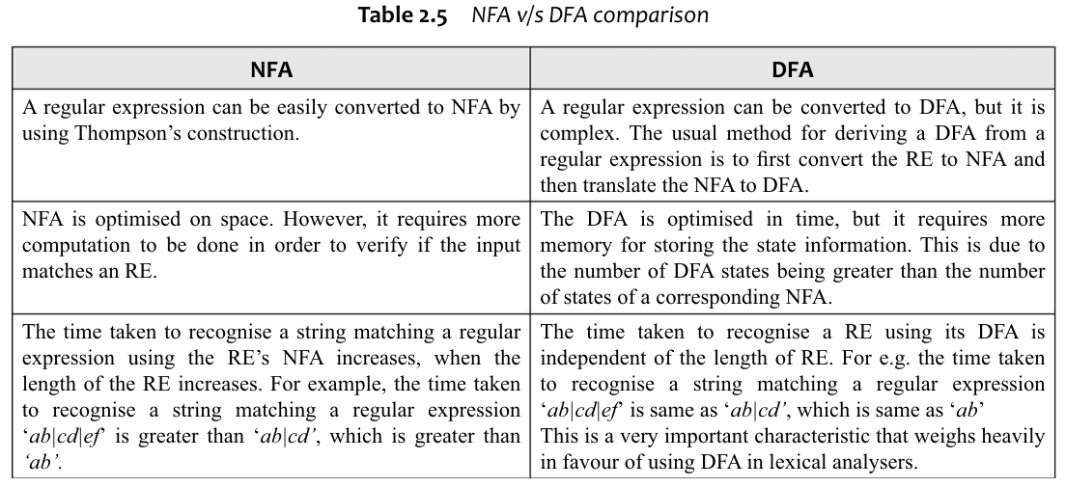
Comparison between DFA and NFA

Slide 12
Deterministic Finite Automata (DFA)

Slide 13
Non-Deterministic Finite Automata (NFA)

Slide 14
Regular Expression
Regular Languages

